Slide 1
"Understanding COVID-19: Cases, Vaccination, and Insights"
By Protogene Hahirwabayo

Slide 2
Why this Topic
Alignment with Computational Group's Work: The focus of the computational group described in the job description is on identifying biomarkers in various disease areas, including infectious diseases such as COVID-19. My interest in understanding COVID-19 cases and vaccination efforts aligns perfectly with the group's research goals and areas of focus.
This Topic Demonstrates My Skills: Solid Background in Statistics and Machine Learning,Proficiency in Python,Experience with Data Management and Dashboard Building,Curiosity and Grit,Opportunity to build and test and develop a more advanced Nature language product

Slide 3
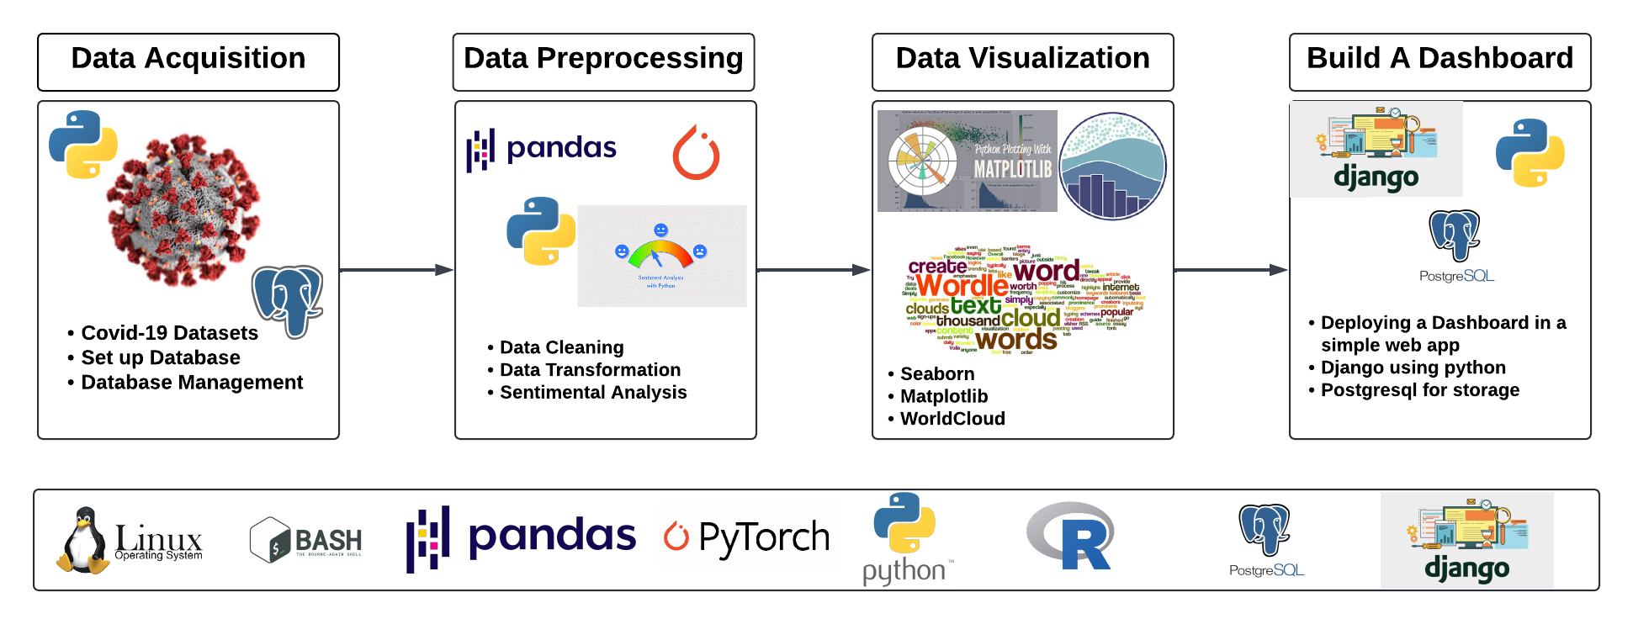
Implementation Steps

Slide 4
Outcome
Understanding of COVID-19 Dynamics
Data-driven Decision Support
Enhanced Public Awareness and Education
Contribution to Research and Innovation
Build an Interactive real-time Dashboard
localhost:Covid_19 Dashboard

Slide 5

Question ?
ANY QUESTIONS

